Slide 1

Cybercrimes Prevention and Reporting
Dr. Iftikhar Alam
CUSIT

Slide 2

Phases of Investigation
Collection
Examination
Analysis
Reporting

Slide 3
Cont…
Digital evidence needs to be:
Admissible It must conform to certain legal rules before it can be put before a court.
Authentic The data must be proven to relate to the incident. This is where additional documentation is important.
Complete It must be impartial and tell the entire account.
Reliable There can be nothing relative to the collection and handling of the evidence that could create any doubt. Chain of Custody procedures become crucial.
Believable The reports and documentation must present everything so it is believable and understandable by a judge or jury.

Slide 4
Prevention (Protecting yourself)
The following are points to consider in how to better protect yourself from being a target of cyber crime:
Have your own personal computer log in at home and work.
Keep your log in information private and secure from others.
Memorize your password(s).
Don’t share it.
Don’t use common dictionary words.
Don’t use family names, colors, hobby data, or religious data.

Slide 5
Cont…
Always LOCK your system when you walk away from your desk.
Avoid, or better yet, never post personal photos of you on a nonsecure Web site.
Never post personal data.
Never provide your password(s), PIN information, or banking details from a soliciting e-mail, or Web site.
Install and run a personal firewall.
Install and run antivirus software.
Install and run antispyware software.
Update your computer frequently with security patches, as well as

Slide 6
Cont…
Operating system and application service packs.
Use encryption for sensitive e-mail and Web transactions.
If you are a Windows user, use the New Technology File System (NTFS), not FAT
If you have a portable device for storing data, use the Encrypting File System (EFS), part of NTFS. This includes laptops, MP3 devices, and portable drives.

Slide 7
Cont…
Make sure your PDA and cell phone have an activation password.
Report any cyber-harassments and/or cyber threats.
Purchase a good shredder—a good cross-cut one!
Don’t use your computer for criminal purposes!
Don’t believe you are anonymous on the Web!

Slide 8
Protecting your family
Make sure there is an open screen policy—meaning the computer display faces the doorway and is exposed for all to see.
Establish time limits on computer use and Internet access.
Try to separate the game systems from the educational system—many families have a computer for games, and another for homework. Having an Xbox, Playstation, or similar device helps.
Talk honestly and frankly about the good, bad, and ugly found on the Internet with your children.

Slide 9
Cont…
Limit your exposure, and theirs, by not posting too much personal data on the Web—especially at sites like MySpace,YouTube, and similar spot.
Chat rooms are full of dirty old men. Just say no to chat rooms.
Let your children know you will read their chats and e-mails, and will contact their friends from time to time. Then, make sure you do so and review those contacts and communications that are inappropriate for your family.
Let your spouse know you have a keylogger and to beware.

Slide 10
Protecting Business
Understand what your business’s appropriate and inappropriate use policies are, and then follow them.
Continue to use the prevention methods discussed for individuals, families, and property.
Follow and enforce strict password management policies.
Clearly communicate security solutions to all employees.
Establish proper audit policies for user accounts, computer accounts, and management tools for server communication.

Slide 11
Cont…
Do not possess unauthorized information or corporate intellectual property.
Do not distribute or use pirated software.
Do not provide access to your computer to any unauthorized individual.
Stay informed about changes to your phone, Internet, intranet, and computer access.

Slide 12
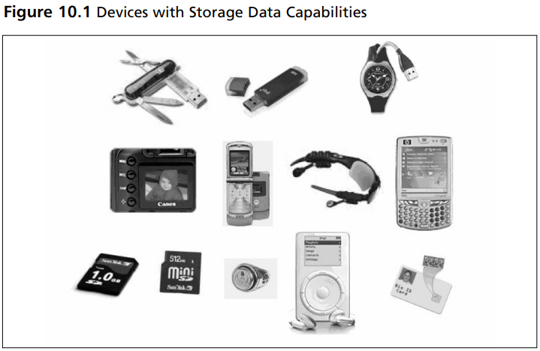
Protecting Govt Agencies

Slide 13
Report Writing
Report Structure
Abstract (or summary)
Table of contents
Body of report
Conclusion
References
Glossary
Acknowledgments
Appendixes

Slide 14
You can use Tools for reporting
Autospy
https://www.autopsy.com/about/

Slide 15
End of lecture
Questions

